Slide 1
Snake Game development in C language
Course: CSE115.2
Group-4
Jayonti Sarker 1911069042
MD Nahim 2514251042
Mohammad Ali 2512818642
Afif Ahmed Chowdhury 2513880642
Farden Hossain 2512532642

Slide 2
Introduction
The game snake game typically involved the player controlling the snake.Developed a classic Snake Game using C.Console-based interface.In this game the snake eating items which make it longer with the objective being to avod ruiing into a border as long as ossible.Focused on learning real-time input handling, logic, and collision detection.
NoKia has installed the snake game” on many of its phoned.the game is also available on several websites.including youtube,which allows viewers to play the game while a video loads.
·Course: CSE115.2
Group-4
Jayonti Sarker 1911069042
MD Nahim 2514251042
Mohammad Ali 2512818642
Afif Ahmed Chowdhury 2513880642
Farden Hossain 2512532642

Slide 3
Game Components
Snake Sprite: Controlled via keyboard. Grows on eating food.
Food : Randomly generated, consumed to grow snake.
Walls: Game boundary. Collision causes game over.
Score Display: Updates on food collision.
·Course: CSE115.2
Group-4
Jayonti Sarker 1911069042
MD Nahim 2514251042
Mohammad Ali 2512818642
Afif Ahmed Chowdhury 2513880642
Farden Hossain 2512532642

Slide 4
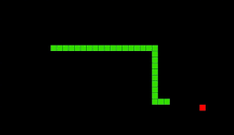
Functional Requirements
The snake is controlled with keyboard keys (W, A, S, D or arrow keys). It grows and the score increases when it eats food. The game ends if the snake hits the wall or its body. _kbhit() and getch() handle input, and directions are locked. Press 'X' to exit the game.
Fig:snake moving
·Course: CSE115.2
Group-4
Jayonti Sarker 1911069042
MD Nahim 2514251042
Mohammad Ali 2512818642
Afif Ahmed Chowdhury 2513880642
Farden Hossain 2512532642

Slide 5
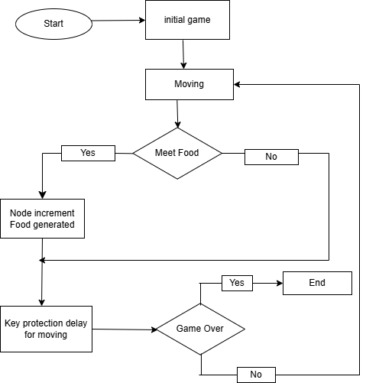
System Overview
The Snake Game in C is a console-based game where the snake moves, eats food to grow. The game starts and goes to the initial setup.The snake keeps moving continuously.
If the snake meets food, it grows and new food is created.
If the snake crashes (into wall or itself), the game is over.
If no crash, the snake keeps moving in a loop.
·Course: CSE115.2
Group-4
Jayonti Sarker 1911069042
MD Nahim 2514251042
Mohammad Ali 2512818642
Afif Ahmed Chowdhury 2513880642
Farden Hossain 2512532642

Slide 6
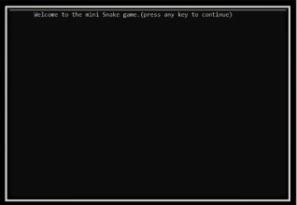
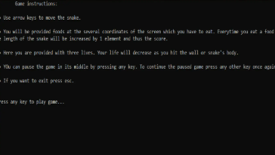
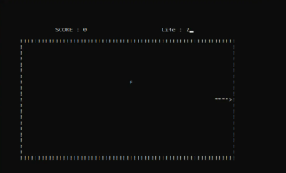
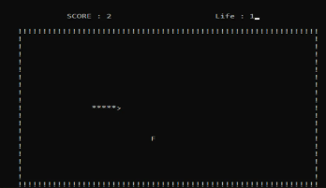
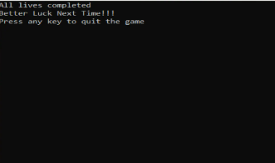
Results
Home page
Main manu
snake moving
642
Farden Hossain 2512532642
Exit
·Course: CSE115.2
Group-4
Jayonti Sarker 1911069042
MD Nahim 2514251042
Mohammad Ali 2512818642
Afif Ahmed Chowdhury 2513880642
Farden Hossain 2512532642
size and score increasing after eating
The game starts from a homepage with a main menu, allows snake movement with real-time input, increases snake length and score after eating food an exit option.·

Slide 7
Significance of the Project
Demonstrates how a complete game can be built using basic C programming.
Serves as a stepping stone for advanced projects (e.g., graphics, AI, networking).
Helps beginners understand real-time processing and event-driven logic.
Promotes interest in logic development and modular programming.
Reinforces learning through a fun and familiar classic game concept.
·Course: CSE115.2
Group-4
Jayonti Sarker 1911069042
MD Nahim 2514251042
Mohammad Ali 2512818642
Afif Ahmed Chowdhury 2513880642
Farden Hossain 2512532642

Slide 8
Future work
So the modification can be done our project:
1.it can be made with good graphics.
2.we can add more options like top scorres and profile player.
3.we can add multiplayer option.
4.we can also implement the project using c++,python,java.
·Course: CSE115.2
Group-4
Jayonti Sarker 1911069042
MD Nahim 2514251042
Mohammad Ali 2512818642
Afif Ahmed Chowdhury 2513880642
Farden Hossain 2512532642

Slide 9
Work Distribution
Jayonti sarker (silde making,video make,report writing ,code writing).
MD Nahim (code writing)
Mohammad Ali (code writing)
Afif Ahmed Chowdhury (code writing)
·Course: CSE115.2
Group-4
Jayonti Sarker 1911069042
MD Nahim 2514251042
Mohammad Ali 2512818642
Afif Ahmed Chowdhury 2513880642
Farden Hossain 2512532642

Slide 10
Conclusion
The project on mind gaming zone has been working efficiently for every moment of game player and various facilities availed by them.One can easily play game with user friendly environment.
It can be implemented with good graphics and better features in the future.
·Course: CSE115.2
Group-4
Jayonti Sarker 1911069042
MD Nahim 2514251042
Mohammad Ali 2512818642
Afif Ahmed Chowdhury 2513880642
Farden Hossain 2512532642

Slide 11

·Course: CSE115.2
Group-4
Jayonti Sarker 1911069042
MD Nahim 2514251042
Mohammad Ali 2512818642
Afif Ahmed Chowdhury 2513880642
Farden Hossain 2512532642

